Slide 1

INTRODUCTION TO the switch

Slide 2
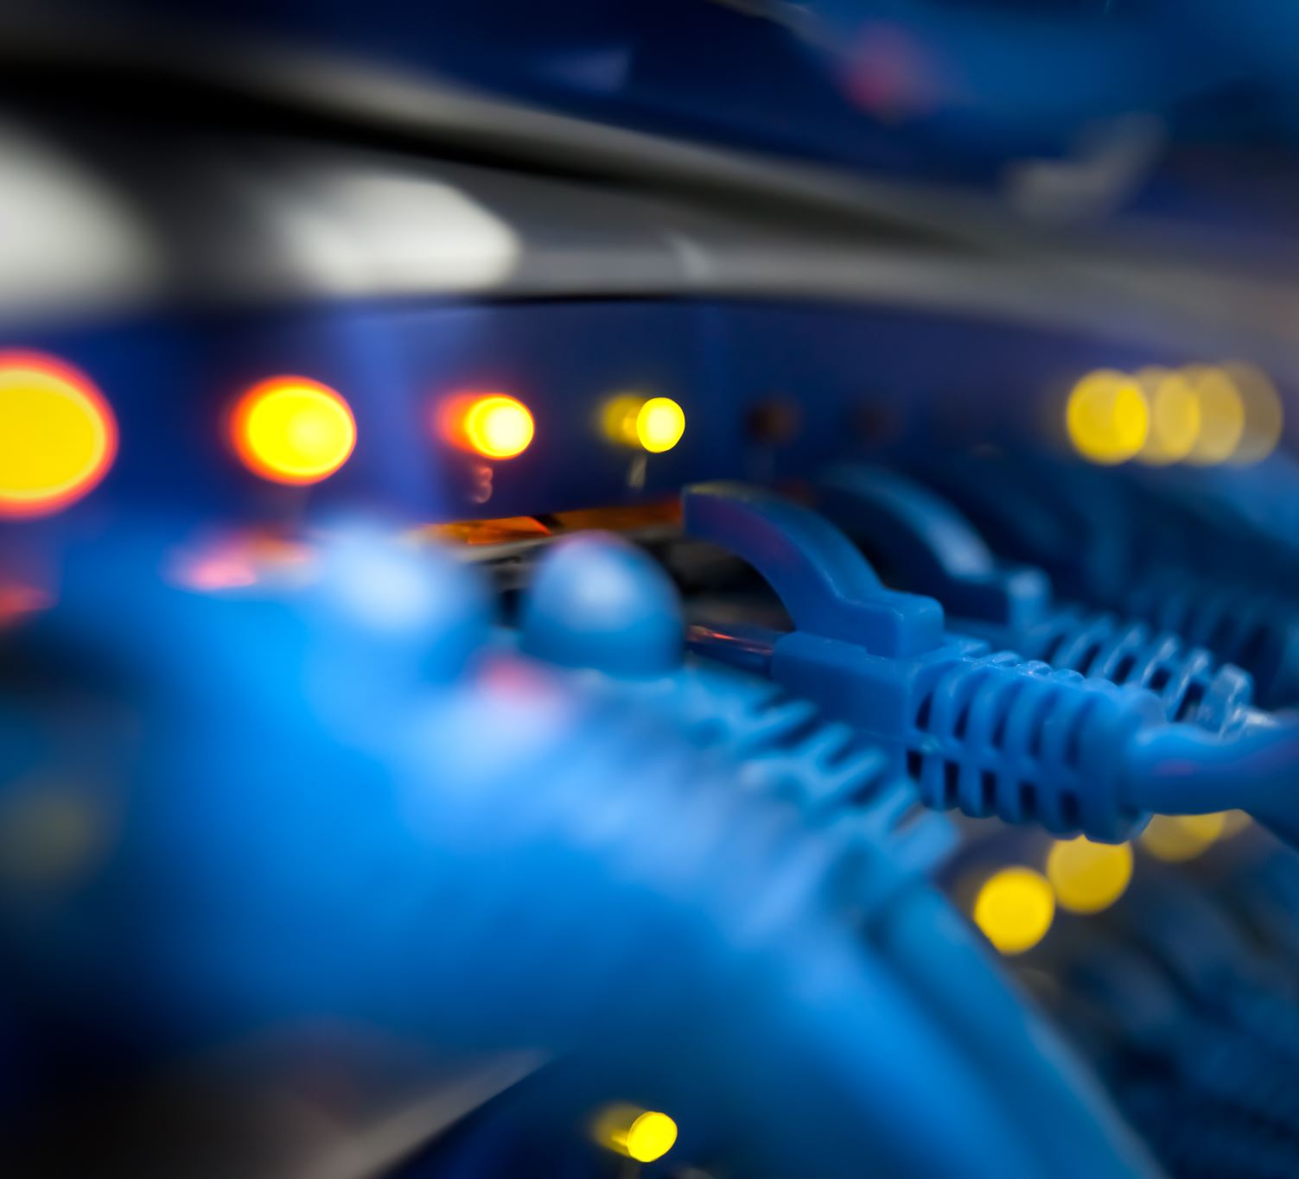
What is a switch?
A switch is a device that forwards incoming data from any of multiple input ports to a specific output port that will take the data toward its destination.

Slide 3
different methods of internetwork switching
Although the most common form of switching is Layer 2 switching, it is important to know that switching can also be performed as Layers 1, 3, and 4, or the OSI Model.
The different methods of internetwork switching described in this section are as follows:
Switching at the Physical Layer
Switching at the Data Link Layer
Switching at the Network Layer
Switching at the Transport Layer
Multilayer Switching (MLS)

Slide 4
Switching at the Physical Layer
Physical Layer Switching operates at Layer 1 of the OSI Model and allows users to connect any port to any other port within the system.
Layer 1 switches use cross-connects to create connections from any port to any other port on the device.
In addition to this, Layer 1 switches also have the ability to convert one media type to another (e.g., Ethernet to Fiber) using cross-connects.
This provides Physical Layer switches the ability to adapt to changes in the network that could occur over time.

Slide 5
Switching at the Data Link Layer
The most commonly known type of Data Link Switching is LAN switching.
A LAN switch is, in many ways, similar to a bridge. Both devices allow you to segment the LAN and create multiple collision domains. However, LAN switches do have several advantages over bridges, which include the following:
More ports than a bridge would ever be capable of supporting
Microsegmentation by allowing individual hosts to be connected to individual ports
Operating at hardware speed using ASICs, versus the software used by bridges
Supporting Layer 3 and Layer 4 packet switching by including Multilayer features
Using VLANs to create smaller logical broadcast domains

Slide 6
Switching at the Data Link Layer cont.
By default, the implementation of switches creates a single broadcast domain,
A broadcast domain is a collection of devices that receive broadcast traffic from each other. Switches will forward broadcast traffic to all interfaces, except the one where it originated from. All hosts can reach each other by broadcasting at the Data Link Layer.
Broadcast domains either can reside within the same LAN segment or can be bridged to other LAN segments.
Switches support VLANs(Virtual Local Area Network), which can be used to create multiple logical broadcast domains
The following are three primary functions of LAN switches:
MAC Address Learning
MAC Address Forwarding and Filtering
Loop Avoidance and Detection

Slide 7
Switching at the Data Link Layer cont.
LAN switches learn Media Access Control (MAC) addresses by examining the source address of each frame received on the interface and using that address to build their forwarding tables.
Switches note the incoming port of frames sourced from a MAC address when the device connected to that port sends a frame to another MAC address.
Because they initially have no idea where the destination device is, switches will broadcast the received frame out of every port, except for the port on which the frame was received.
After the switch has flooded the broadcast packet, it will wait for a device to respond. When the intended destination device responds to the broadcast packet, the switch will note the port the response was received on and place that address into the forwarding table, which is also called the MAC address table.
This same process is repeated until the switch has learned the MAC addresses of all devices connected to all of its ports. These addresses are then stored in the MAC address table.

Slide 8
Switching at the Data Link Layer cont.
The third primary function of LAN switches is Layer 2 loop avoidance.
A Layer 2 loop occurs when there are multiple redundant paths in the Layer 2 network and the paths are all in a forwarding state at the same time.
If this happens, the links will continuously forward frames, resulting in the creation of a network loop.
To prevent such incidents from occurring, LAN switches use the Spanning Tree Protocol (STP)

Slide 9

questions

Slide 10
Switching at the Network Layer
Layer 3 switches are simply routers that allow for the faster forwarding of packets by using hardware instead of software.
In traditional network routers, before a packet is forwarded, the router must perform a route lookup, decrement the packet TTL, recalculate the checksum, and then the frame can be forwarded using the appropriate Layer 2 information. The processor or CPU, using software, typically performs all of these functions.
Although Layer 3 Cisco switches, such as the Catalyst 6500 series, still use standard routing protocols (e.g., OSPF and EIGRP) to determine the best path to the destination, they use dedicated hardware to forward packets whenever a complete switched path exists between two hosts.
This allows packets to be forwarded at Layer 2 speeds, although Layer 3 protocols are still used to determine the best path to the destination.

Slide 11
Switching at the Network Layer cont.
Layer 3 switching provides the following advantages over Layer 3 routing:
Hardware-based packet forwarding
High-performance packet switching
High-speed scalability
Low latency
Lower per-port cost
Flow accounting
Security
Quality of Service (QoS)

Slide 12
Switching at the Transport Layer
Layer 4 switching provides additional routing above Layer 3 by using the port numbers found in the Transport Layer header to make routing decisions.
Packets are forwarded, in hardware, based on Network Layer addressing and Transport Layer application information, protocol types, and segment headers.
The largest benefit of Layer 4 switching is that the network administrator can configure a Layer 4 switch to prioritize data traffic by application, which means a QoS can be defined for each user.
However, this also means that Layer 4 switches require a lot of memory in order to keep track of application information and conversations.
Layer 4 switches can use information up to Layer 7 to perform packet switching. These switches typically are referred to as Layer 4-7 switches, content switches, content services switches, web switches, or application switches.

Slide 13
Multilayer Switching
Multilayer Switching (MLS) combines Layer 2, Layer 3, and Layer 4 switching technologies to forward packets at wire speed using hardware.
Cisco supports MLS for both Unicast and Multicast traffic flows.
In Unicast transmission, a flow is a unidirectional sequence of packets between a particular source and destination that share the same protocol and Transport Layer information. These flows are based on only Layer 3 address information.
In Multicast transmission, a flow is a unidirectional sequence of packets between a Multicast source and the members of a destination Multicast group. Multicast flows are based on the IP address of the source device and the destination IP Multicast group address.

Slide 14
The Benefits of VLANs
LAN switches provide several advantages. These advantages include increased bandwidth to users via microsegmentation and supporting VLANs, which increase the number of Broadcast domains while reducing their overall size.
VLANs solve some of the scalability problems of large, flat networks by breaking down a single bridged domain into several smaller bridged domains.
However, it is important to understand that routing is instrumental in the building of scalable VLANs because it is the only way to impose hierarchy on the switched VLAN internetwork.
The advantages provided by implementing VLANs include the following:
They increase network security by logical segmentation.
They increase network flexibility and scalability.
They can be used to enhance or improve network performance.
They reduce the size of broadcast domains.
They allow for differentiation between traffic types, such as voice and data.
They aid in the ease of network administration and management.

Slide 15
User and Voice vlans
Usually, IP phones sit next to a computer on the same desk. They require the same UTP cables as computers and also use Ethernet. If we want to connect them to a switch, we have two options.
You could connect the computer and IP phone using two different cables
This will work but it has some disadvantages:
You need to install a new cable from the switchport to the IP phone.
You will lose a switchport for the IP phone.
To solve this, most IP phones (including Cisco) have a three port switch inside of the IP phone:
One port connects to the switch.
One port connects to the computer.
One (internal) port connects to the phone.
This allows us to connect the IP phone and computer
You probably want to separate the data from the computer and IP phone. This is where user and voice VLANs come into play. Each VLAN will have its own network.
The computer will be in a user VLAN, the IP phone will be in the voice VLAN

Slide 16
questions

Slide 17
Configuration modes
There are mainly 5 modes in the switch:
User execution mode
Privileged mode
Global configuration mode
Interface configuration mode
ROMMON mode

Slide 18
User Execution mode
As soon as the interface up message appears and press enter, the router> prompt will pop up. This is called user execution mode. This mode is limited to some monitoring commands.
Privileged mode
As we type enable to user mode, we enter into Privileged mode where we can view and change the configuration of the router. Different commands like show running-configuration, show IP interface brief, etc can run on this mode which is used for troubleshooting purposes.
Global configuration mode
As we type configure terminal to the user mode, we will enter into the global configuration mode. Commands entered in these modes are called global commands and they affect the running configuration of the router. In this mode, a different configuration like making a local database on the router by providing username and password can set enable and secret password, etc.

Slide 19
Interface Configuration mode
In this mode, only the configuration of interfaces is done. Assigning an IP address to an interface, bringing up the interface are the common tasks done in this mode.
Rommon mode
We can enter this mode when we interrupt the boot process of the router. Generally, we enter in this mode while the password recovery process or Backing up of IOS on devices like TFTP server. It is like the BIOS mode of a PC.

Slide 20
Different Types of Switch Ports
Network devices connect to a switch through its switch ports.
Switch Ports which are physical opening where data cables are plugged in to connect the devices.
Switch port type should be configured according to the requirement considering the factors like network architecture, speed and functionality.
Switch ports can be classified in following types based on network architecture :
Access Port
Trunk Port
Hybrid Port
Switch ports can be classified in following types based on the functionality :
Combo Port :
Stack Port :
PoE (Power over Ethernet) Port

Slide 21
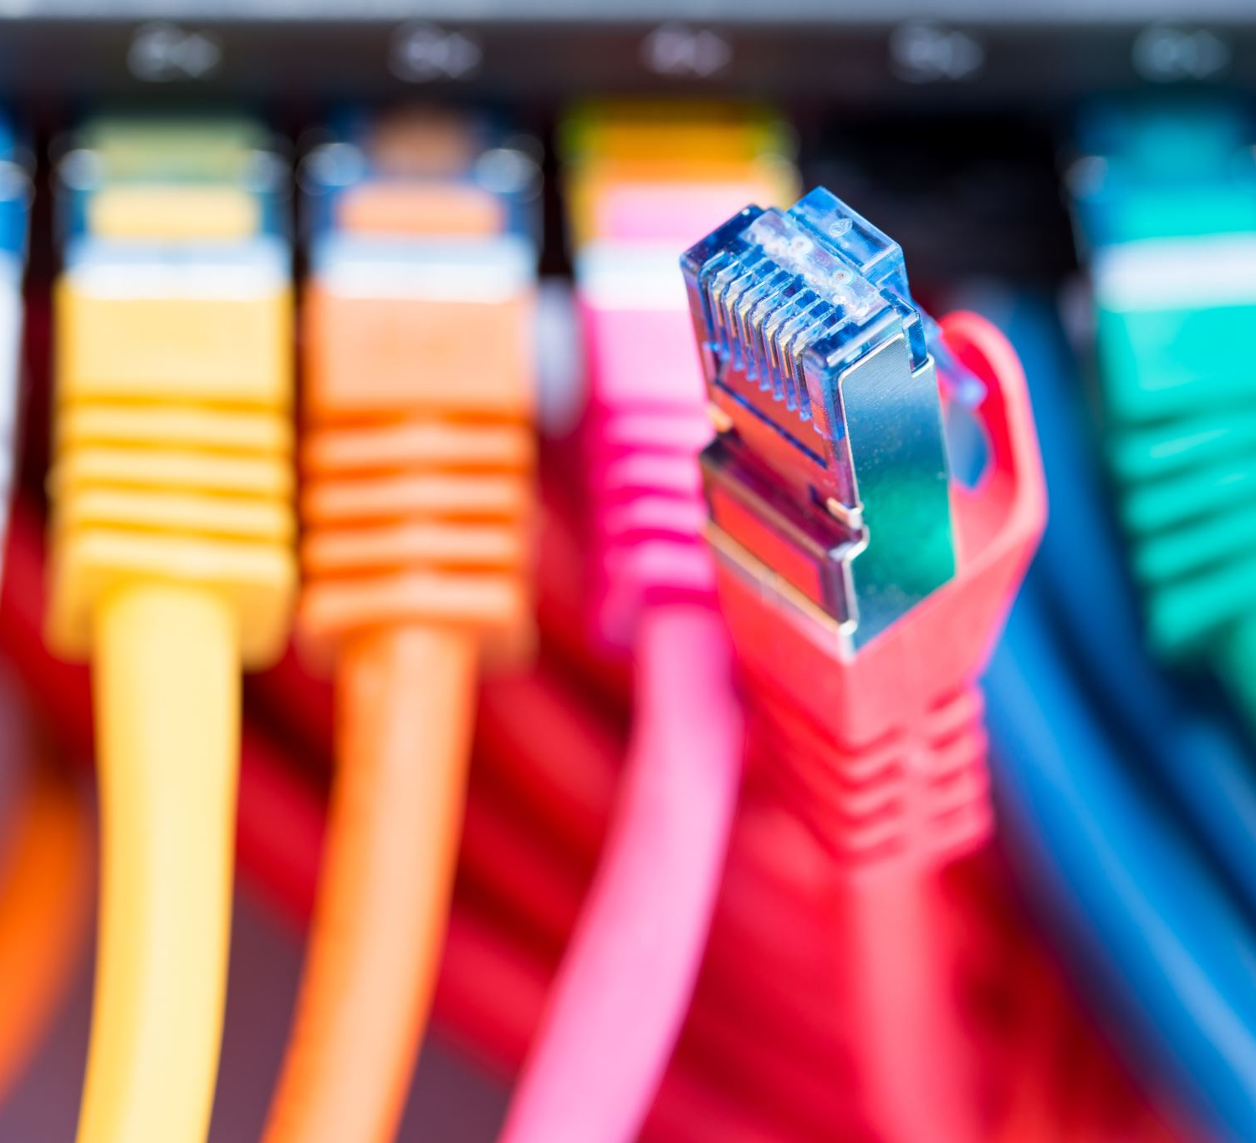
Accesss ports
Access port is a connection on a switch that transmits data to and from a specific VLAN.
It is used to connect switches to host devices such as desktops, laptops, printers etc., only available in access link.
It sends and receives Ethernet frames in untagged form from access VLAN.
It can only be member of single VLAN i.e. the access VLAN, and discards all frames that are not classified to the access VLAN.

Slide 22

Trunk ports
Trunk port is a connection on a switch that transmits data to and from multiple VLANs.
It is used to connect switches to other switches, routers and servers available in trunk link.
Frames are marked with unique identifying tags when they move between switches so that they can be directed to their designated VLANs.
It can manage traffic for numerous VLANs at the same time.

Slide 23
802.1Q Encapsulation Explained
If you want to VLAN traffic between switches we have to use a trunk. A trunk connection is simply said nothing more but a normal link but it is able to pass traffic from different VLANs and has a method to separate traffic between VLANs.
Encapsulation is characterised as wrapping up one unit of data. It is the structure that connects the programme and the information it controls
There are two trunking protocols:
802.1Q: This is the most common trunking protocol. It’s a standard and supported by many vendors.
ISL: This is the Cisco trunking protocol. Not all switches support it.

Slide 24

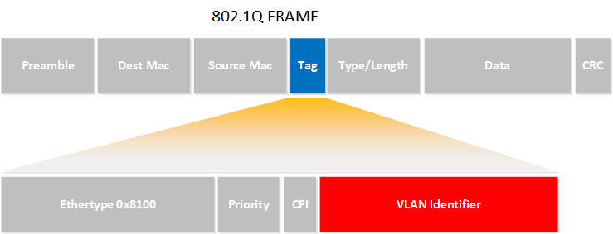
802.1q cont.
Normal Ethernet fram
802.1Q Fame
As you can see it’s the same as a normal Ethernet frame but we have added a tag in the middle (that’s the blue field). In our tag you will find a “VLAN identifier” which is the VLAN to which this Ethernet frame belongs. This is how switches know to which VLAN our traffic belongs.

Slide 25
Hybrid ports
Hybrid port is a connection on a switch that transmits data to and from one or multiple VLANs.
It is used to connect network devices (like switches) as well as user devices (like laptops).
It support both tagged and untagged frames from VLANs.
It can receive frames from one or more VLANs at the same time.

Slide 26
Combo ports
t is a compound port which can support two different physical ports with same switch fabric and port number but both the ports can’t be used simultaneously.
It is used to configure the switch according to the application requirements.

Slide 27
Stack ports
It is a special functional port which is used to connect with other stackable switches of the same model, brand and software version to operate as a single stackable switch with port capacity equal to the sum of the combined switches.
It is used for making long distance connections.

Slide 28
Poe ports
It allows a single network cable to carry data and power simultaneously.
It is used in devices such as wireless network repeaters or IP security cameras which use a single Ethernet cable for voice, data and power.

Slide 29
questions

Slide 30
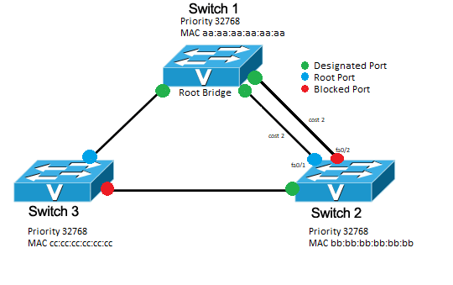
Spanning tree
Spanning-tree is a protocol that runs on our switches that helps us to solve loops. Spanning-tree is one of the protocols that you must understand as a network engineer.

Slide 31
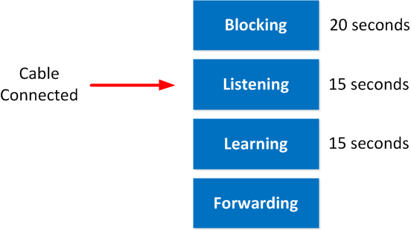
Spanning tree cont.
If you have played with some Cisco switches before, you might have noticed that every time you plugged in a cable, the led above the interface was orange and after a while became green. What is happening at this moment is that spanning-tree is determining the state of the interface; this is what happens as soon as you plug in a cable:
The port is in listening mode for 15 seconds. In this phase, it will receive and send BPDUs, still, neither learning MAC addresses nor data transmission.
The port is in learning mode for 15 seconds. We are still sending and receiving BPDUs, but now the switch will also learn MAC addresses. Still no data transmission, though.
Now we go in forwarding mode, and finally, we can start transmitting data!

Slide 32
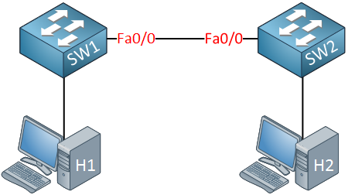
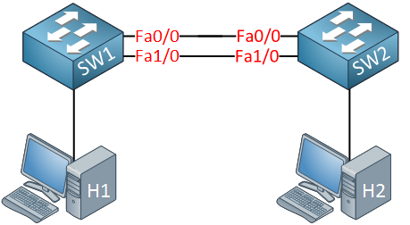
Why do we need spanning-tree?
What is a loop, and how do we get one?
We have two switches connected with a single cable, so there is a single point of failure. To get rid of this single point of failure, we will add another cable.
With the extra cable, we now have redundancy. Unfortunately for us, redundancy also brings loops

Slide 33
Loops cont.
H1 sends an ARP request because it’s looking for the MAC address of H2. An ARP request is a broadcast frame.
SW1 will forward this broadcast frame on all it interfaces, except the interface where it received the frame on.
SW2 will receive both broadcast frames.
Now, what does SW2 do with those broadcast frames?
It will forward it from every interface except the interface where it received the frame.
This means that the frame that was received on interface Fa0/0 will be forwarded on Interface Fa1/0.
The frame that was received on Interface Fa1/0 will be forwarded on Interface Fa0/0.
Both switches will keep forwarding over and over again until the following happens:
You fix the loop by disconnecting one of the cables.
One of your switches will crash because they are overburdened with traffic.
Ethernet frames don’t have a TTL (Time to Live) value, so they will loop around forever.

Slide 34
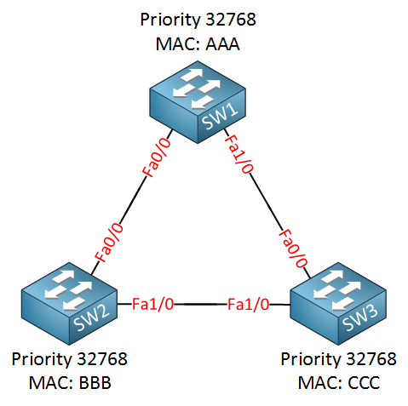
How spanning trees solves loops
Spanning-tree will help us to create a loop-free topology by blocking certain interfaces.
We have three switches, and as you can see, we have added redundancy by connecting the switches in a triangle, this also means we have a loop here. I have added the MAC addresses but simplified them for this example:
SW1: MAC AAA
SW2: MAC BBB
SW3: MAC CCC
Since spanning-tree is enabled, all our switches will send a special frame to each other called a BPDU (Bridge Protocol Data Unit). In this BPDU, there are two pieces of information that spanning-tree requires:
MAC address
Priority
The MAC address and the priority together make up the bridge ID.

Slide 35
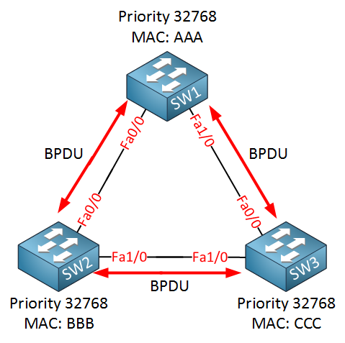
How spanning trees solves loops
Spanning-tree requires the bridge ID for its calculation.
First of all, spanning-tree will elect a root bridge; this root bridge will be the one that has the best “bridge ID”.
The switch with the lowest bridge ID is the best one.
By default, the priority is 32768, but we can change this value if we want.
SW1 will become the root bridge! Priority and MAC address make up the bridge ID. Since the priority is the same on all switches, it will be the MAC address that is the tiebreaker. SW1 has the lowest MAC address thus the best bridge ID and will become the root bridge.
The ports on our root bridge are always designated, which means they are in a forwarding state.

Slide 36
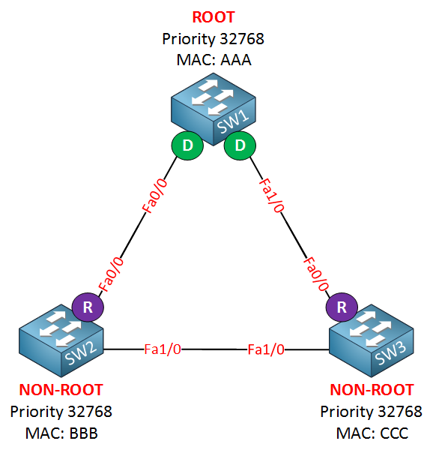
How spanning trees solves loops
Now we have agreed on the root bridge, our next step for all our “non-root” bridges (so that’s every switch that is not the root) will have to find the shortest path to our root bridge! The shortest path to the root bridge is called the “root port”
Their Fa0/0 interface is the shortest path to get to the root bridge. The “shortest path” in spanning-tree means it will actually look at the speed of the interface. Each interface has a certain cost, and the path with the lowest cost will be used.
We have designated ports on our root bridge and root ports on our non-root bridges, we still have a loop, however, so we need to shut down a port between SW2 and SW3 to break that loop. So which port are we going to shut down? The one on SW2 or the one on SW3?
Lower is better, both switches have the same priority, but the MAC address of SW2 is lower, which means that SW2 will “win this battle”. SW3 is our loser here which means it will have to block its port, effectively breaking our loop.

Slide 37
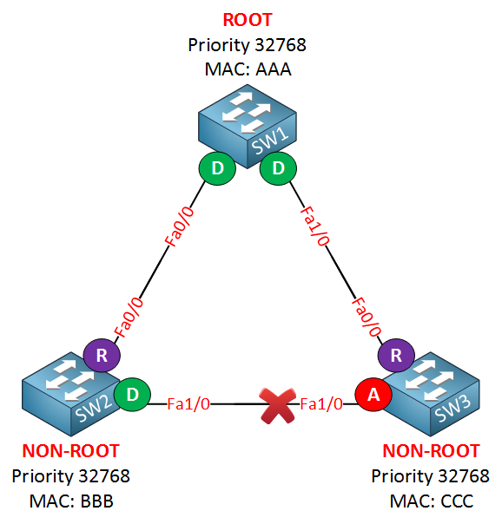
How spanning trees solves loops
If you look at the link between SW2 and SW3, you can see that the Fa1/0 interface of SW3 says “A” which stands for alternate. An alternate port is blocked! Sometimes the alternate port is called the ND (Non Designated) port. By shutting down this interface, we have solved our loop

Slide 38
Spanning tree portfast
Portfast is a Cisco proprietary solution to deal with spanning-tree topology changes.
Portfast does two things for us:
Interfaces with portfast enabled that come up will go to forwarding mode immediately, the interface will skip the listening and learning state.
A switch will never generate a topology change notification for an interface that has portfast enabled.
It’s a good idea to enable portfast on interfaces that are connected to hosts because these interfaces are likely to go up and down all the time.
DON’T ENABLE PORTFAST ON A INTERFACE TO ANOTHER HUB OR SWITCH

Slide 39
questions

